Slide 1

PROJECT BASED LEARNING • SEMESTER 5
Fuzzy Controller for Camera Autofocus
Course: Fuzzy Logic and Genetic Algorithms | Branch: Electronics & Communication Engineering
Submitted by
Tharakan Rahil Ramchandran
Shivam Nandi
Arun Rathore
240280111146
240280111139
240280111157
L.D. College of Engineering, Ahmedabad
Academic Year 2026–27

Slide 2

Introduction
Autofocus (AF) automatically brings the subject into sharp focus by moving the lens - no manual adjustment needed.
Classical AF uses contrast / sharpness “hill-climbing”: on-sensor sharpness peaks exactly at correct focus. Conventional autofocus controllers rely on precise mathematical models relating lens position to image sharpness.
The sharpness – lens-position relationship is non-linear, noisy, and hard to model exactly with conventional threshold-based control. However, the relationship between focus error, scene contrast, and lens movement is inherently non-linear, noisy and difficult to model exactly.
Fuzzy Logic Control (FLC) applies human-like linguistic IF–THEN rules, giving smooth, robust lens-motor commands , even in the presence of uncertainty and imprecise sensor data.
Illustrative — Contrast Hill-Climb

Slide 3

Problem Statement & Objectives
OBJECTIVES
THE PROBLEM
Conventional autofocus controllers rely on precise, threshold-based mathematical models linking lens position to sharpness. Under noisy, imprecise sensor data this produces abrupt, non-adaptive lens adjustments — motivating a fuzzy, heuristic approach.
1
Identify the input / output variables of the AF controller
2
Define the universe of discourse & linguistic variables
3
Design triangular / trapezoidal membership functions
GOAL
4
Construct an 8-rule fuzzy rule base
Design a two-input, single-output Mamdani FLC that commands smooth, accurate lens-motor steps for intelligent, adaptive autofocus.
5
Fuzzify a sample input, evaluate rules & defuzzify (weighted average)

Slide 4


System Architecture
Mamdani-type Fuzzy Inference System (FIS) — two inputs, one output
Sharpness Error (E)
Range: −10 to +10
Current sharpness − previous sharpness
Lens Motor Step (O)
FUZZY
CONTROLLER
Range: −50 to +50
(+ forward, − backward)
Rate of Change (dE)
Range: −5 to +5
Trend / speed of focus-quality change
Mamdani Fuzzy Inference System

Slide 5

Input & Output Variables
Variable | Range | Unit | Linguistic Values
Sharpness Error (E) | −10 to +10 | Normalized contrast units | NL, NS, Z, PS, PL
Rate of Change of Error (dE) | −5 to +5 | Contrast units / sample | N, Z, P
Lens Motor Step (O) | −50 to +50 | Motor steps (+ fwd / − bwd) | NL, NS, Z, PS, PL
Linguistic value legend
NL = Negative Large NS = Negative Small Z = Zero PS = Positive Small PL = Positive Large N = Negative Z = Zero P = Positive

Slide 6

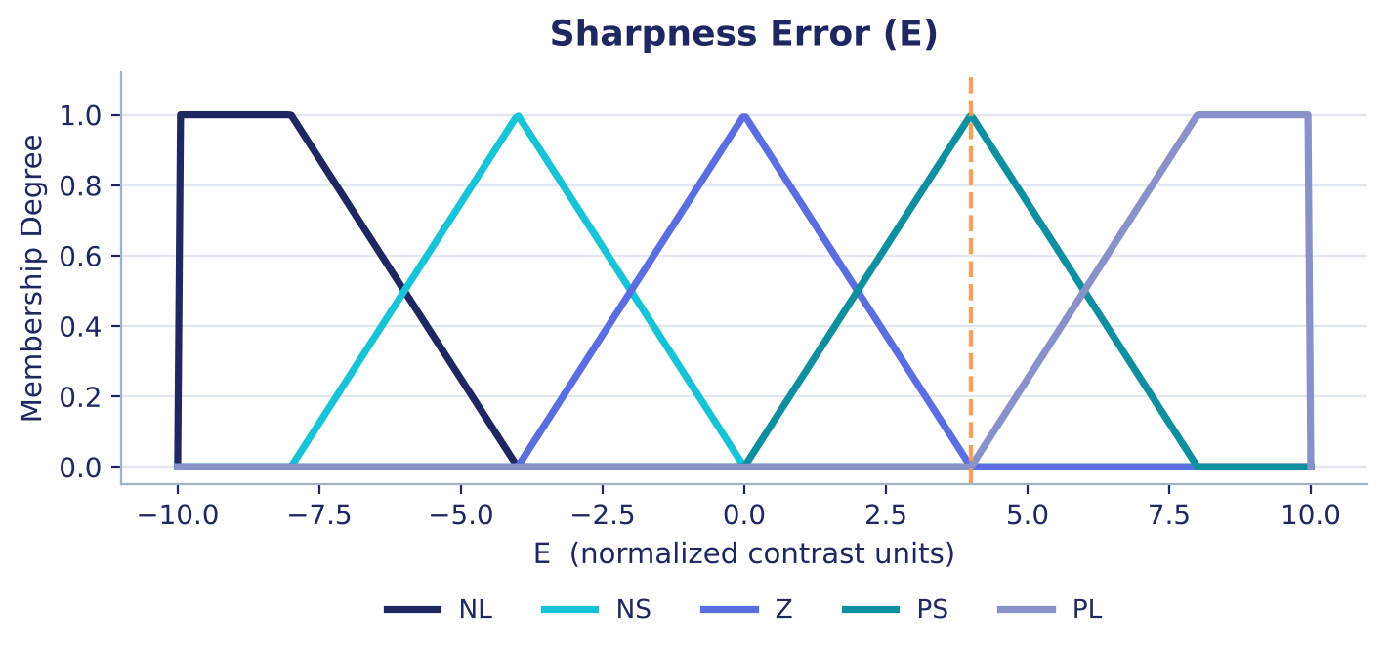
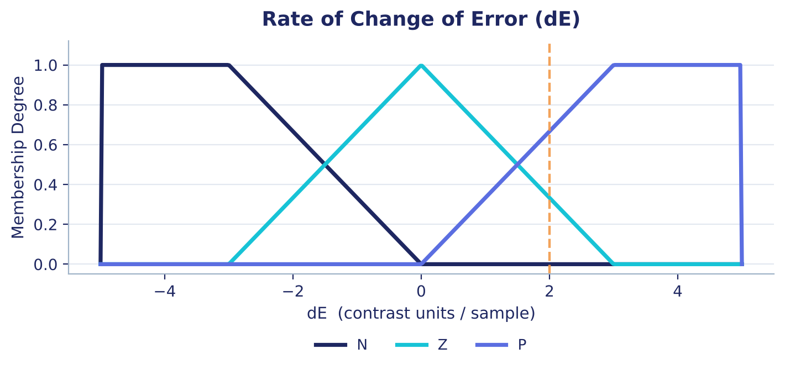
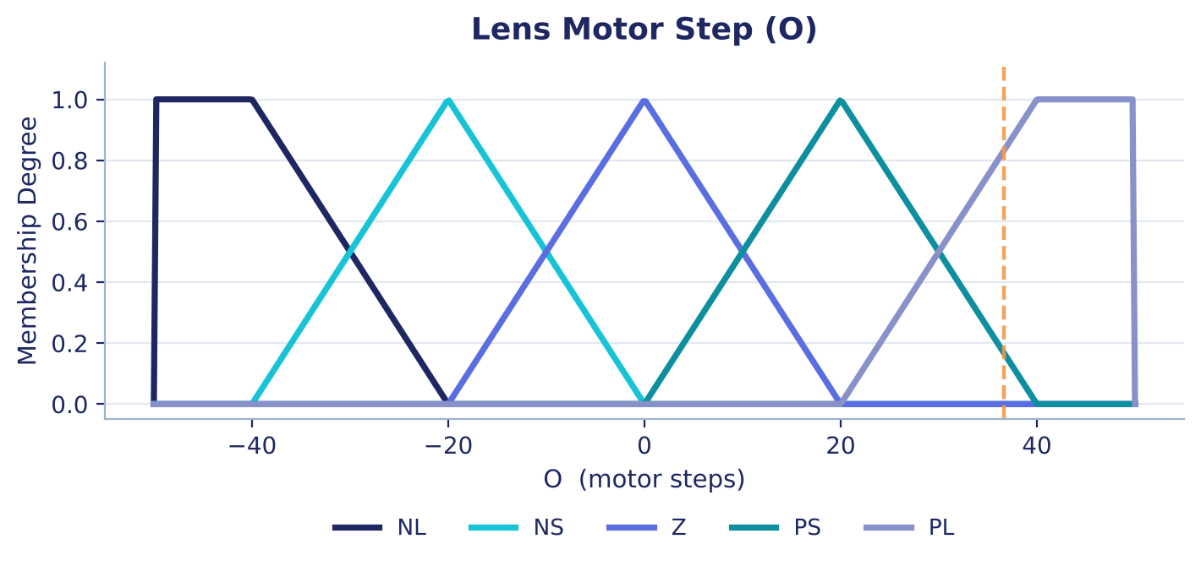
Membership Functions
Triangular & trapezoidal shapes — computationally light, ideal for a real-time embedded camera processor.
Trapezoidal sets (NL, PL) model saturation at the extremes of each universe of discourse.
Triangular sets model the intermediate, gradually-transitioning values.
Fig. 1 — Sharpness Error (E)
Fig. 2 — Rate of Change (dE)
Fig. 3 — Lens Motor Step (O)

Slide 7

Fuzzy Rule Base
Rule | IF E is | AND dE is | THEN O is
R1 | NL | N | NL
R2 | NL | Z | NL
R3 | NS | N | NS
R4 | NS | Z | NS
R5 | Z | Z | Z
R6 | PS | Z | PS
R7 | PS | P | PL
R8 | PL | P | PL
READING A RULE
R7
IF Sharpness Error is Positive Small AND Rate of Change is Positive, THEN Lens Motor Step is Positive Large.
Focus is degrading further away and worsening quickly — a large corrective step is issued in time to prevent focus hunting.
min (AND) used for rule conjunction: w = min(μE, μdE)

Slide 8




Python Implementation
NumPy
Matplotlib
scikit-fuzzy
Builds the discretized universes of discourse for E, dE and O
Plots membership functions and the fuzzification / result figures
Antecedent / Consequent objects, Mamdani rule evaluation engine
CORE INFERENCE (EXCERPT)
INFERENCE PIPELINE
E['PS'] = fuzz.trimf(E.universe, [0, 4, 8])
dE['P'] = fuzz.trapmf(dE.universe,[0,3,5,5])
rule7 = ctrl.Rule(E['PS'] & dE['P'], O['PL'])
system = ctrl.ControlSystem(rules)
sim = ctrl.ControlSystemSimulation(system)
sim.input['E'], sim.input['dE'] = 4, 2
sim.compute()
1
2
3
4
Fuzzification
Rule Evaluation
(min / AND)
Aggregation
Defuzzification
Crisp output → Lens Motor Step (O)

Slide 9

Manual Fuzzy Inference — Worked Example
Sample input: E = 4 | dE = 2
Rule | μE | μdE | Firing Strength w | Output Set
R6: PS, Z → PS | 1.000 | 0.333 | 0.333 | PS
R7: PS, P → PL | 1.000 | 0.667 | 0.667 | PL
z* = Σ(wᵢ × zᵢ) / Σ(wᵢ) = (0.333×20 + 0.667×45) / 1.000 = 36.675 ≈ 36.68 steps
Representative peak values used: Z = 0, PS = 20, PL = 45 (plateau mid-point)
36.68
30.61
Weighted Average (this report’s method)
Centroid — Standard Mamdani (scikit-fuzzy)
Blends only each set’s representative peak, weighted by firing strength
Uses the full shape of each aggregated output set

Slide 10

Testing & Results
Test | E | dE | O*
T1 | 4 | 2.0 | 36.67
T2 | -4 | -2.0 | -20.00
T3 | 0 | 0.0 | 0.00
T4 | 9 | 4.0 | 45.00
T5 | -9 | -4.0 | -45.00
T6 | 8 | 4.0 | 45.00
T7 | -8 | -4.0 | -45.00
T8 | 2 | 0.5 | 15.00
T9 | -2 | -0.5 | -11.43
T10 | 6 | -2.0 | 20.00
T11 | -6 | 2.0 | -32.50
T12 | 0 | 4.0 | 0.00
T13 | 5 | -4.0 | 0.00
T14 | -5 | 3.0 | 0.00
!
3 of 14 cases (T12–T14, orange) fired no rule → O* = 0: a rule-base coverage gap found during testing.

Slide 11



Applications, Limitations & Future Scope
Applications
Limitations
Future Scope
Smartphone & mirrorless/DSLR autofocus
CCTV / surveillance auto-tracking cameras
Embedded & IoT camera modules needing low-compute control
Software-only simulation — no physical lens / motor tested
8-rule base leaves some (E, dE) pairs uncovered (O*=0 seen in testing)
No integral/memory term — may be prone to hunting near focus
Complete rule base to all 15 E×dE combinations
Integrate with real stepper-motor + image-sensor hardware
Auto-tune membership functions from recorded AF traces; add a 3rd input (scene contrast)

Slide 12

Conclusion
Designed and simulated a two-input, single-output Mamdani FLC for camera autofocus using Python and scikit-fuzzy.
Triangular/trapezoidal membership functions and an 8-rule base map Sharpness Error and its Rate of Change to Lens Motor Step.
Manual worked example (E = 4, dE = 2) validated against the report: weighted-average O* = 36.68 motor steps.
Testing across 14 input combinations confirmed smooth, rule-consistent behaviour and revealed a rule-base coverage gap for future refinement.
Key learning outcome: fuzzy logic translates heuristic, human-like reasoning into a computationally-light, interpretable controller for non-linear, noisy real-world systems.
Thank you — Questions welcome

